Slide 1
What is OOP?
Definition: A paradigm that organizes software design around objects rather than functions.
Key Concepts:
Class
Object
Attribute
Method
__init__ (Constructor)

Slide 2
Key Concepts Explained
Class: Blueprint/template for creating objects.
Object: Instance of a class (e.g., a specific machine).
Attribute: Data associated with an object (e.g., color, model).
Method: Functions inside a class that perform operations.

Slide 3
Example: Car
Attributes: Color, model, engine capacity.
Methods: start(), stop(), accelerate()

Slide 4
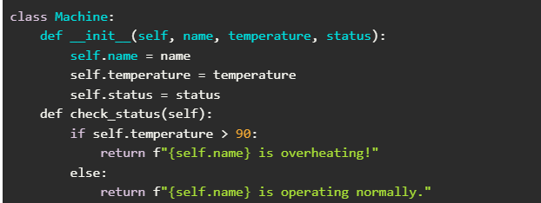
Basic Class Example

Slide 5

Creating Objects

Slide 6
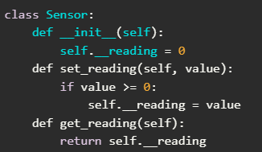
Encapsulation

Slide 7
Why OOP is Useful?
Reusability: Define once and reuse.
Organization: Structured and easy to manage.
Scalability: Useful for large projects.

Slide 8
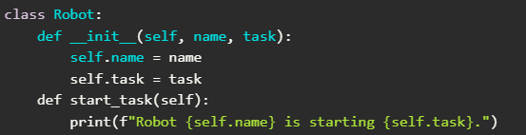
Example: Robot Class
Attributes: Name, task.
Methods: start_task(), stop_task()

Slide 9
Inheritance
Definition: Allows a class to inherit properties and methods from another class.
Types:
Single
Multiple
Multilevel
Hierarchical
Hybrid

Slide 10
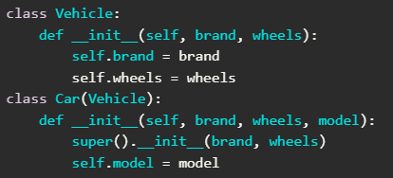
Example: Inheritance

Slide 11
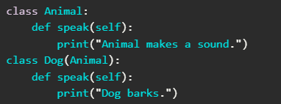
Polymorphism
Definition: Child class can redefine methods from the parent class.

Slide 12
Conclusion
Summary: OOP is a powerful paradigm that enhances code reusability, organization, and scalability.
Encouragement: Start experimenting with creating your own classes and objects!

